Slide 1
COVID-19 and the Hasty Dissolution of Life Boundaries
Luke Campbell, MA | SE Regional Behavioral Health Coordinator

Slide 2
Agenda
Boundaries: What Are They?
Physical, Emotional, Time, Intellectual, Material
Life Changes Caused by COVID-19
Emotional Impact of Dissolution of Boundaries
Ways to Offset the Impact
Safe-Place Visualization

Slide 3
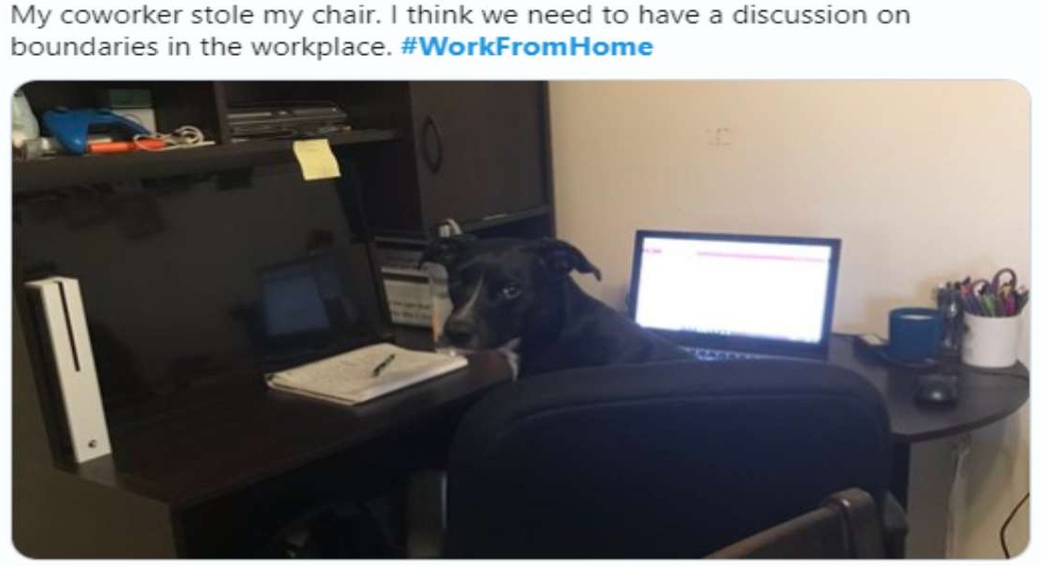
How would you describe personal boundaries?

Slide 4
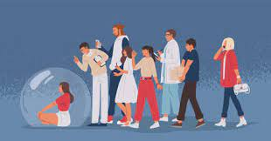
“Personal boundaries are the limits and rules we set for ourselves within relationships. A person with healthy boundaries can say “no” to others when they want to, but they are also comfortable opening themselves up to intimacy and close relationships.”

Slide 5
Boundaries: What Are They?
Physical Boundaries - including our need for personal space, our comfort with touch, and our basic physical needs such as rest, food, and water.
Unwanted physical touch
Denial of physical needs (rest, relaxation, time off, opportunity to eat or drink water)
Invasion of personal space
Emotional Boundaries - relates to the respect and honor of feelings and energy. Setting these boundaries means understanding our capacity to accept and limit emotional energy. Respecting emotional boundaries means validating the feelings of others and making sure you respect their ability to take in emotional information.
Dismissing or criticizing feelings
Asking inappropriate questions
Emotional dumping

Slide 6
Boundaries: What Are They (Continued)?
Time Boundaries – Our time is important, valuable, and belongs to us. We should be allowed the opportunity to decide how and when we spend our time at work, home, family, and friends.
Asking employees to work without pay
Demanding time from people
Being late or cancelling meetings
Contacting someone when they are unavailable
Intellectual Boundaries – Respect for the thoughts, ideas, and curiosities of others. This can occur when thoughts and ideas are dismissed and disrespected. We all deserve to have our beliefs and opinions heard and considered so long as they are healthy and respectful.
Material Boundaries – Care and respect for someone’s personal possessions.
Frequently borrowing or using someone’s possessions
Destruction of personal property

Slide 7
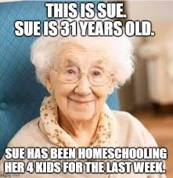
What are the ways in which your life boundaries have been altered by COVID-19?

Slide 8
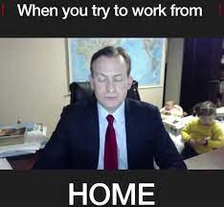
COVID-19 and the Life Changes
Social Isolation and Disconnection
Change of Job Function
Job Loss
Physical and Mental Health
Loss of Health Security and Safety
Economic and Financial Strain
Destruction of Daily Routine
Distorted Sense of Time - “Groundhog’s Day”
Blurred Roles (Worker, Teacher, Parent, Spouse)
Loss of Free Time

Slide 9
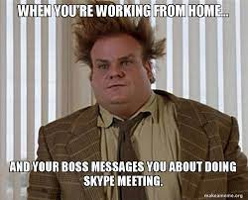
The Emotional Impact
Fear, Anger, Anxiety, Sadness, Worry, Numbness, and Frustration
Changes in appetite, energy, and activity levels
Difficulty with concentration and making decisions
Difficulty sleeping or nightmares
Headaches, body pains, stomach problems, and skin rashes
Worsening chronic health problems
Increased use of alcohol, tobacco, or illicit drugs

Slide 10
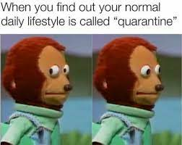
Ways to Offset the Emotional Impact
Boundaries
Identify boundary breaches and blurring
Practice using assertive communication (not passive or aggressive)
Know your limits!
Self-Care
Avoid and reduce alcohol consumption
Make healthy food choices and get plenty of sleep
Connect with friends and family
Be intentional about taking breaks and finding time to relax
Find ways to increase physical activity and exercise

Slide 11
Before You Go…
Safe-Place Visualization

Slide 12
Sources
https://uhs.berkeley.edu/sites/default/files/relationships_personal_boundaries.pdf
https://www.mindbodygreen.com/articles/six-types-of-boundaries-and-what-healthy-boundaries-look-like-for-each
https://emergency.cdc.gov/coping/selfcare.asp#:~:text=%2D%20Feelings%20of%20feelings%20of,tobacco%2C%20or%20other%20drugs
https://fortune.com/2021/03/09/covid-pandemic-how-life-has-changed-coronavirus-one-year-later-march-2020/

Slide 13
Regional Behavioral Health Coordinators
Janet Yeats, MA, LMFT (Metro) ​ Janet.R.Yeats.Contractor@state.mn.us​
Bill Maloney, MSW, LICSW (Northwest & Northeast) Bill.Maloney.Contractor@state.mn.us​
Kevynn Schumacher, MS (West Central & Central) Kevynn.Schumacher.Contractor@state.mn.us​
Hanna Marzinske, MBA (Southwest & South Central) Hanna.Marzinske.Contractor@state.mn.us​
Luke Campbell, MA (Southeast)​ Luke.Campbell.Contractor@state.mn.us

Slide 14
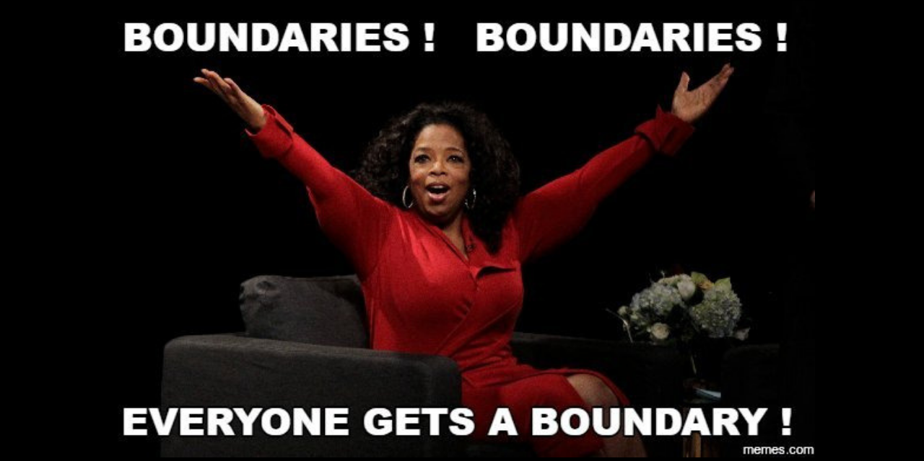
Thank You!
Luke Campbell
Luke.campbell.contractor@state.mn.us

